Slide 1
"Bouncing Ball"

Slide 2
Project Team Members
Roll No | Name | GitHub Link
22 | Aishwarya Sanjay Bhirud | https://github.com/AishwaryaBhirud
35 | Khemangi Pramod Chaudhari | https://github.com/KhemangiChaudhari
57 | Jayesh Vasant Falak | https://github.com/JayeshFalak
82 | Akshay Ashok Mahajan | https://github.com/akshay123z
91 | Aaditya Bhagwan Mali | https://github.com/Aaditya2m
75 | Nikhil Vijay Konge | https://github.com/nikk6

Slide 3
Introduction
Bouncing Ball is an addictive game where players control a bouncing ball.
The goal is to keep the ball bouncing as long as possible and avoid obstacles.
It offers simple yet engaging gameplay for players of all ages.

Slide 4
Overview of the game
Bouncing Ball is an exciting and fast-paced game where players control a ball that bounces through a dynamic environment.
The game offers a unique blend of skill, timing, and reflexes, making it both challenging and addictive.
Players must navigate the ball through various levels or an endless mode, avoiding obstacles and aiming for high scores.
The game features intuitive controls, responsive gameplay, and visually appealing graphics, enhancing the overall gaming experience.

Slide 5
Technical details
Software Requirement:-
For running this game we need a basic system of python.
Software needed for this game :-
Pycharm Community
Thnnoy
Vscode
Etc,.
This game is develop in Python and run in python.

Slide 6
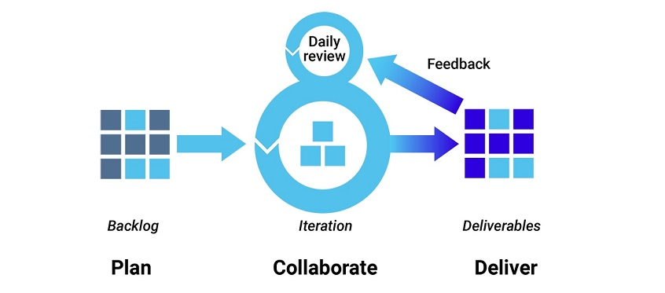
Software Process Using Agile Methodology
1. Agile development methodology
Teams use the agile development methodology to minimize risk (such as bugs, cost overruns, and changing requirements) when adding new functionality. In all agile methods, teams develop the software in iterations that contain mini-increments of the new functionality. There are many different forms of the agile development method, including scrum, crystal, extreme programming (XP), and feature-driven development (FDD).

Slide 7
2. DevOps deployment methodology
DevOps is not just a development methodology but also a set of practices that supports an organizational culture. DevOps deployment centers on organizational change that enhances collaboration between the departments responsible for different segments of the development life cycle, such as development, quality assurance, and operations.

Slide 8
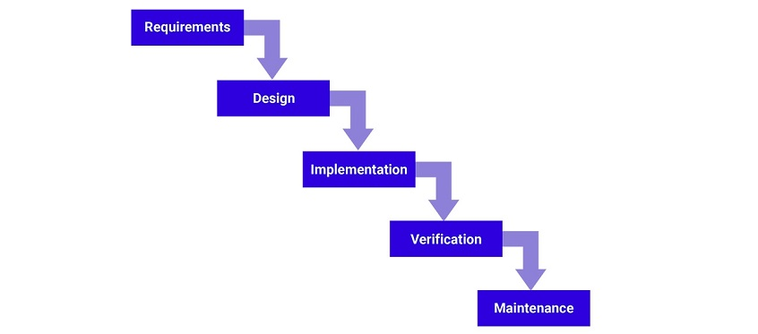
3. Waterfall development method
Many consider the waterfall method to be the most traditional software development method. The waterfall method is a rigid linear model that consists of sequential phases (requirements, design, implementation, verification, maintenance) focusing on distinct goals. Each phase must be 100% complete before the next phase can start. There’s usually no process for going back to modify the project or direction

Slide 9
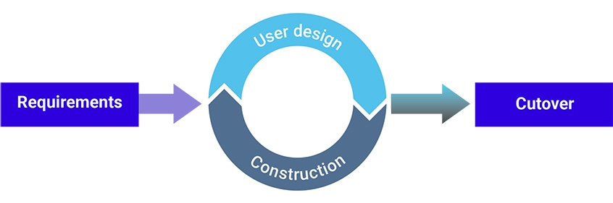
4. Rapid application development
Rapid application development (RAD) is a condensed development process that produces a high-quality system with low investment costs. Scott Stiner, CEO and president of UM Technologies, said in Forbes, “This RAD process allows our developers to quickly adjust to shifting requirements in a fast-paced and constantly changing market.” The ability to quickly adjust is what allows such a low investment cost.

Slide 10
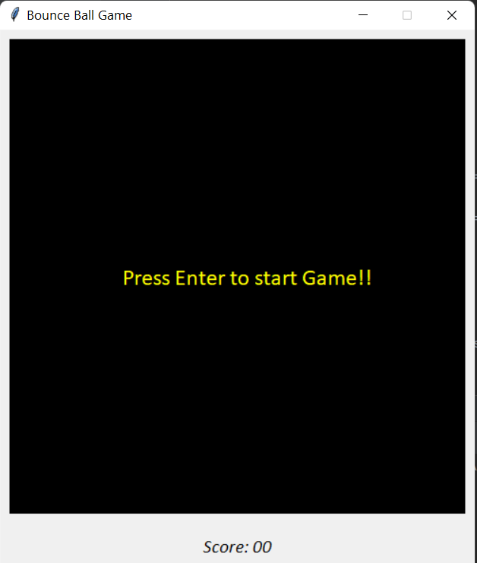
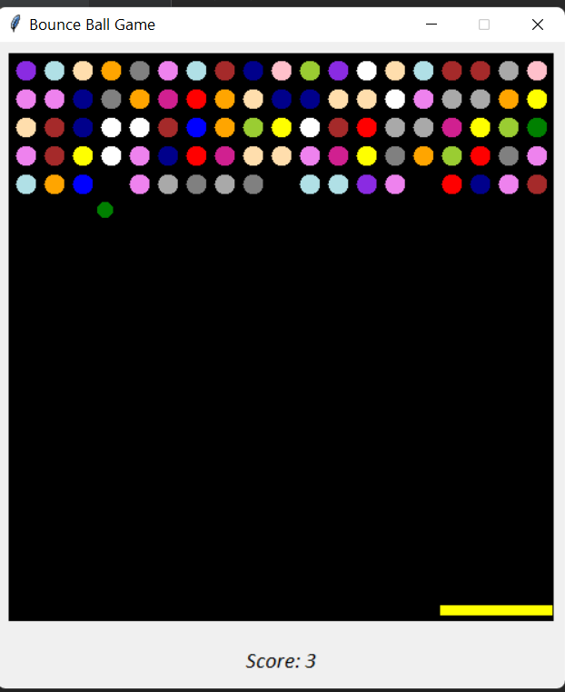
Preview

Slide 11
Features of the game
Intuitive controls for easy gameplay
Dynamic obstacles that require quick reflexes
Collectible power-ups for temporary advantages
Engaging levels with increasing difficulty
Endless mode for ultimate challenges
High score tracking for competition
Stunning visuals and animations
Catchy sound effects and music
Smooth performance on various devices
Player-friendly interface for easy navigation

Slide 12
Thank You..

